Slide 1


HOTEL BOOKING ANALYSIS
For the year 2015-2017
Presented by Shakthi sivaranjani

Slide 2
BUSINESS OBJECTIVE
  To analyze hotel booking performance between 2015 and 2017 to identify revenue trends and demand patterns.
  To evaluate cancellation behavior, occupancy levels, and seasonal impact on business performance.
  To provide data-driven recommendations to improve revenue, reduce cancellations, and optimize overall performance.
Presented by shakthi sivaranjani

Slide 3
DATASET OVERVIEW
  The dataset includes hotel booking records from 2015 to 2017 covering 119,385 bookings.
  It captures key metrics such as revenue (₹4.27 Cr), cancellations (44,220), occupancy rate (63%), and average stay duration (3.43 nights).
  The data covers both City and Resort hotels, enabling comparative and seasonal performance analysis.
Presented by shakthi sivaranjani

Slide 4
TOOLS USED
SQL scripts (Cleaning & analysis queries )
Power BI (Intent visualization & Dashboard)
1.
2.
Finalreport (Insights and Findings) >> Word or Pdf
Presentation (recommendation) >> PPT
3.
4.
Presented by Shakthi sivaranjani

Slide 5

GOAL
  ·Identify factors leading to cancellations.
  ·Analyze demand patterns across City Hotel and Resort Hotel.
  ·Evaluate customer behaviour, seasonal trends, and market segments.
  ·Provide data-driven recommendations to improve occupancy rates, reduce cancellations, and enhance revenue strategies.
Presented by Shakthi sivaranjani

Slide 6
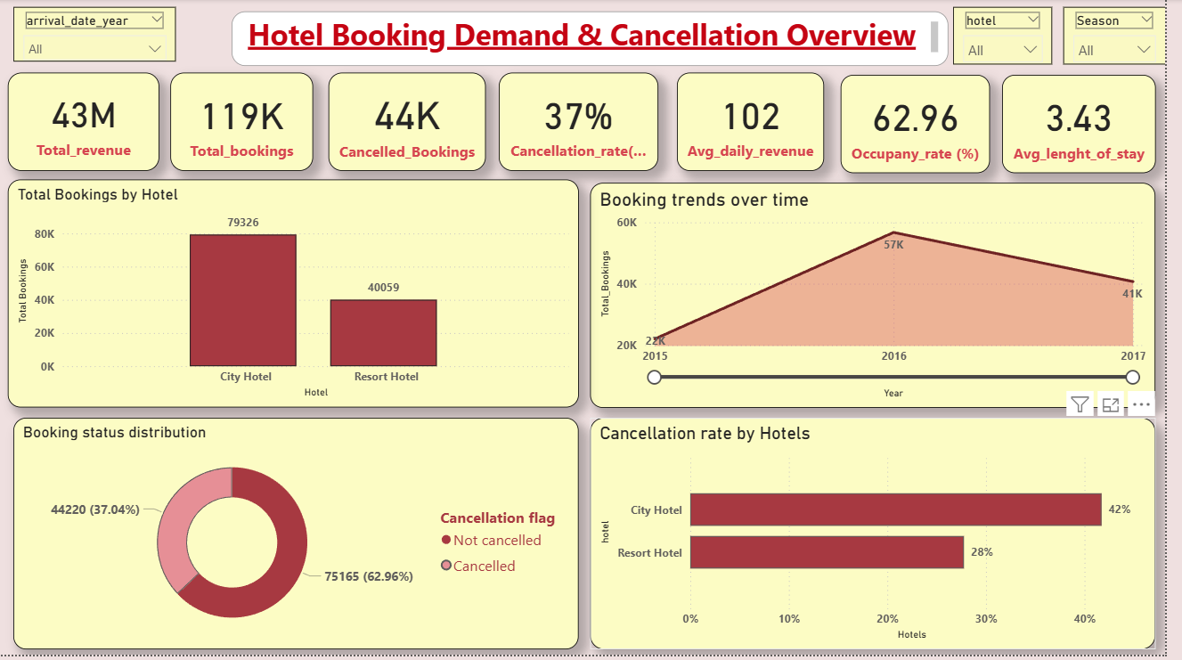
DASHBOARD : 1
Hotel booking demand and cancellation overview
Presented by Shakthi sivaranjani

Slide 7
RECOMMENDATION : 1
1. Control High Cancellations (37%)
  Introduce stricter cancellation policies for City Hotels.
  Apply partial deposit for high lead-time bookings.
2. Improve Occupancy (Currently 63%)
  Launch targeted promotions during low-demand months.
  Offer bundled or weekend packages.
3. Increase Length of Stay (3.43 nights average)
  Introduce long-stay discounts (Stay 4 nights, get 10% off).
  Create business and family stay packages.
4. Focus on City Hotel Risk
  Since City Hotel has 42% cancellations, improve booking confirmation strategies for this segment.
Presented by Shakthi sivaranjani

Slide 8
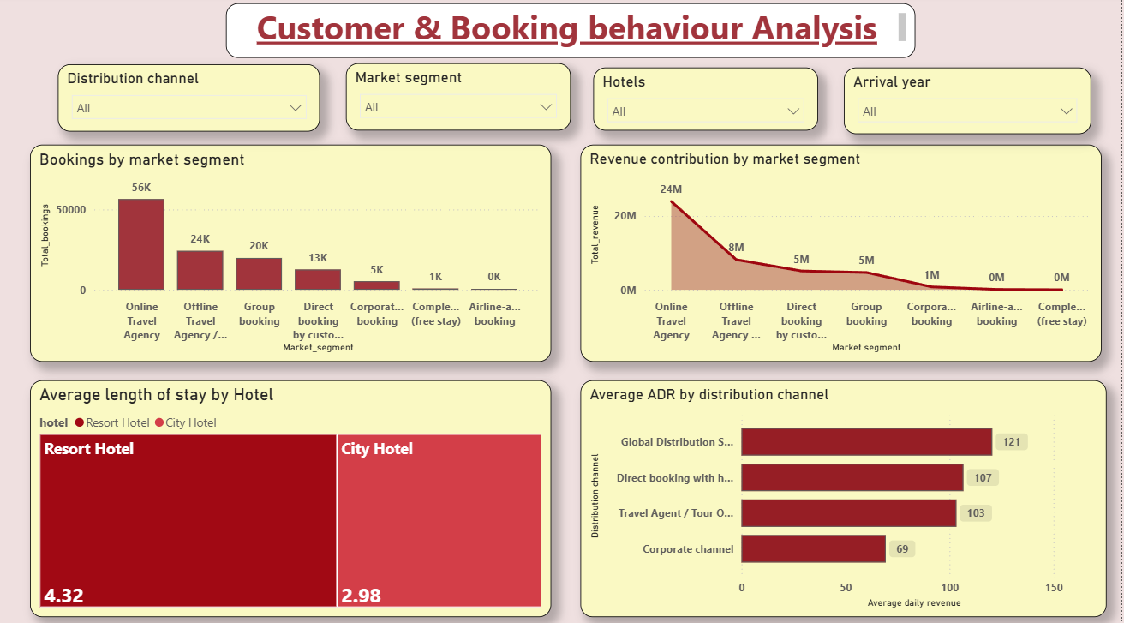
DASHBOARD : 2
Customer & Booking behaviour analysis
Presented by Shakthi sivaranjani

Slide 9
RECOMMENDATION : 2
1. Reduce Dependency on OTAs (56K bookings)
  Encourage more direct bookings to reduce commission costs.
  Offer website-only discounts or loyalty benefits.
2. Promote Resort Long-Stay Advantage
  Since average stay is 4.32 nights, promote long-stay resort packages.
  Target families and vacation travelers.
3. Strengthen Direct Booking Channel
  Direct booking ADR is 107, which is strong.
  Improve website experience and digital marketing campaigns.
4. Rework Corporate Strategy
  Corporate ADR is only 69.
  Introduce premium corporate packages or revise pricing agreements.
Presented by Shakthi sivaranjani

Slide 10
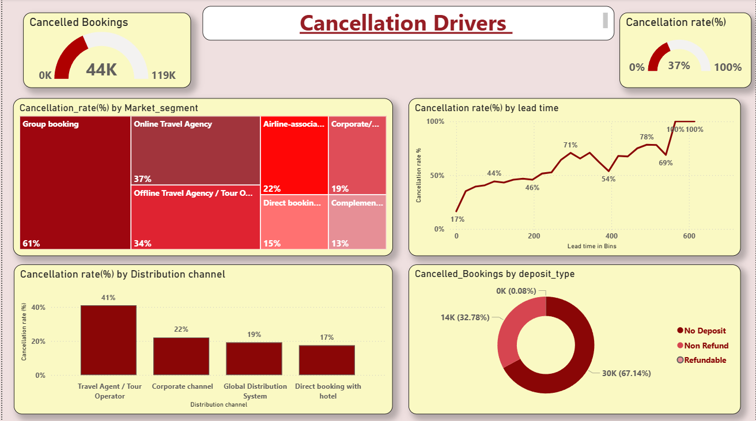
DASHBOARD : 3
Cancellation Drivers
Presented by Shakthi sivaranjani

Slide 11
RECOMMENDATION : 3
1. Control High-Risk Segments
  Group bookings (61%) and OTA bookings (37%) need stricter policies.
  Introduce partial or staged deposits for these segments.
2. Adjust Policies for Long Lead-Time Bookings
  Since cancellations reach up to 70–100% at long lead times:
    Apply stricter cancellation deadlines.
    Offer flexible pricing instead of free cancellations.
3. Promote Direct Bookings
  Direct channel has only 17% cancellation rate.
  Encourage customers to book directly through the hotel website.
4. Implement Deposit-Based Strategy
  Since 67% of cancellations come from no-deposit bookings:
    Introduce minimum deposit requirements.
    Offer discounts for non-refundable bookings.
Presented by Shakthi sivaranjani

Slide 12
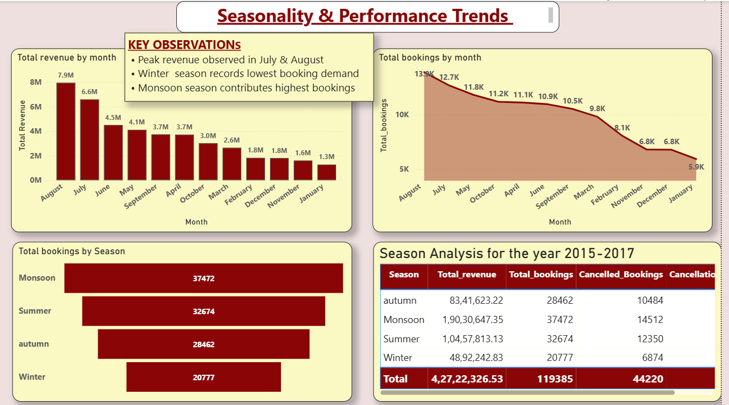
DASHBOARD : 4
Seasonality trends
Presented by Shakthi sivaranjani

Slide 13
RECOMMENDATION : 4
1. Maximize Peak Season Revenue
• Apply dynamic pricing during July & August.
• Introduce premium Monsoon packages.
2. Improve Winter Performance
• Launch targeted offers in November–January.
• Provide early-bird and bundled discounts to increase occupancy.
3. Reduce Seasonal Cancellations
• Implement stricter cancellation policy during peak season.
• Encourage rescheduling instead of cancellation.
4. Plan Resources Based on Seasonality
• Increase staffing and inventory in peak months.
• Optimize operational costs during low-demand season.
Presented by Shakthi sivaranjani

Slide 14
ANALYSIS
  Between 2015–2017, the hotel generated ₹4.27 Crores from 119K bookings, demonstrating strong overall demand growth.
  However, a high cancellation rate of 37% and an occupancy rate of 63% indicate revenue leakage and underutilized capacity.
  City Hotels contribute the highest bookings but also face significantly higher cancellation risk compared to Resort Hotels.
  Business performance is highly seasonal, with peak demand in July–August and weak performance during winter months.
  The average stay duration of 3.43 nights suggests an opportunity to increase guest retention and overall revenue per booking.
Presented by Shakthi sivaranjani

Slide 15
CONCLUSION
The hotel shows strong booking demand and good revenue performance overall. However, high cancellations and unused room capacity reduce the actual profit. By reducing cancellations, improving occupancy during slow months, and increasing the average stay duration, the hotel can improve revenue and achieve more stable growth. By implementing minimum deposit requirements to avoid more cancellation in No deposit bookings .
Presented by Shakthi sivaranjani

Slide 16
THANK YOU

